Slide 1
MEGHA DEY
Linux Kernel Engineer
Interrupt Message Store
A scalable interrupt mechanism for the cloud

Slide 2
AGENDA
Evolution of I/O virtualization
Scalable I/O Virtualization (SIOV) architecture
The interrupt story so far
Need for Interrupt Message Store
Interrupt Message Store advantages
Linux* IRQ subsystem
Hierarchical domains
Linux IMS design
IMS example use case
Current status
Summary

Slide 3

Evolution of I/O Virtualization
Device emulation
Para virtualization
Direct device assignment
Single root I/O virtualization (SR-IOV)
Scalable I/O virtualization (SIOV)
Software techniques
Hardware assisted
@twitter handle

Slide 4
Evolution of I/O Virtualization
Device emulation
Device emulation
SIOV
Para virtualization
SR-IOV
SR-IOV
Direct device assignment
Para virtual I/O
SIOV
Scalability
Scalability: Sharing of I/O devices across different VMs
Performance: How fast guest OS can access device
Direct device assign
Performance
@twitter handle

Slide 5
SIOV Architecture
GUEST 1
GUEST 2
GUEST n
VIRTUAL DEVICE 1
VIRTUAL DEVICE 2
VIRTUAL DEVICE n
…..………
SLOW PATH
SLOW PATH
HOST VMM S/W
SLOW PATH
FAST PATH
FAST PATH
FAST PATH
Each ADI may use multiple interrupts
VDCM
FAST PATH
VDCM
VDCM
AN SIOV DEVICE
ADI 1
ADI 2
ADI 3
……………
ADI m
…………
BR 1
BR 2
BR 3
BR 4
BR K
VDCM: Virtual Device Composition Module ADI: Assignable Device Interface BR: Backend Resources
@twitter handle

Slide 6
SIOV Devices
Is there a matching interrupt mechanism?
GPU devices
Reconfigurable FPGA devices
RDMA capable devices
High-performance devices
High bandwidth network controller devices
Data accelerators
INTERRUPT MESSAGE STORE (IMS)
NVM Express* storage controllers
@twitter handle

Slide 7
The Interrupt Story… So Far
MSI
  Pin based
  Wired
  Shared
  Reduced performance
  Memory write
  Stored as address/data pairs
  Never shared
  Max 32 messages
  Extension to MSI
  Stored in MSI-X table
  Individually configurable
  Max of 2048 vecs
Is 2048 enough?
Legacy interrupts
MSI-X
MSI: Message Signaled Interrupt
@twitter handle

Slide 8
Need for IMS
GUEST 1
GUEST 2
GUEST n
n = 1000
VIRTUAL DEVICE 1
VIRTUAL DEVICE 2
VIRTUAL DEVICE n
…..………
SLOW PATH
SLOW PATH
HOST VMM S/W
SLOW PATH
FAST PATH
FAST PATH
FAST PATH
m = 2
VDCM
FAST PATH
VDCM
VDCM
AN SIOV DEVICE
ADI 1
ADI 2
ADI 3
……………
ADI m
k = 2
…………
BR 1
BR 2
BR 3
BR 4
BR K
Total interrupt messages required = n * m * k = 1000 * 2 * 2 = 4000 (>> 2048)
@twitter handle

Slide 9
Interrupt Message Store
Unified or multiple
Follows MSI-X format
Device can support both IMS and MSI-X
Uses remappable format
Access through host driver
Device specific
No limit on size
On-device
or system memory
@twitter handle

Slide 10
IMS advantages
Dynamic
Unified or multiple
Access through host driver
Device specific
No limit on size
Reduced OS enabling
Scalable
On-device or system memory
Flexible
@twitter handle

Slide 11
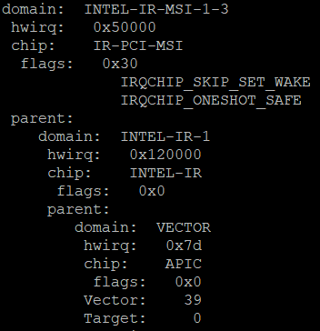
Linux* Interrupt Subsystem
1. IRQ chip
2. IRQ domain
3. IRQ desc
4. IRQ data
Global unique Linux IRQ number
Controller local HWIRQs
@twitter handle

Slide 12
Hierarchical Domains
Vector
APIC
Intel IR 0
Intel IR 1
DMAR-MSI
INTEL IR
DMAR-MSI
IRQ domain
Device C
IRQ CHIP
IO APIC IR 0
Intel IR MSI
IO IR APIC
IR PCI MSI
Device A
Device B
Interrupt delivery path in a modern X86 system
@twitter handle

Slide 13
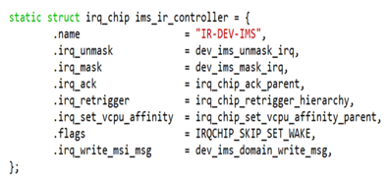
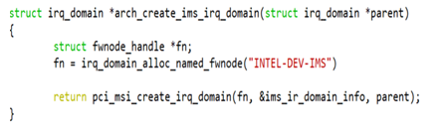
Linux* IMS Design
IRQ core: (arch/x86/kernel/apic/)
Create IMS chip, IMS domain
IRQ remapping: (drivers/iommu/)
Support IMS domain
X86 core: (arch/x86)
Setup/teardown mechanisms
Drivers core: (drivers/base)
Allocate and free IRQs, IRQ chip callbacks
dev_ims_alloc_irqs
dev_ims_free_irqs
@twitter handle

Slide 14
Where does IMS fit in?
Vector
APIC
Intel IR 0
Intel IR 1
DMAR-MSI
INTEL IR
DMAR-MSI
IRQ domain
Device C
IRQ CHIP
IO APIC IR 0
Intel IR MSI
Intel Dev IMS
IO IR APIC
IR PCI MSI
IR DEV-IMS
Device A
Device B
Device D
Interrupt delivery path in a modern X86 system
@twitter handle

Slide 15
Driver Changes to Support IMS
Device specific callbacks:
mask, unmask, write_msg
Driver must specify:
Size of device IMS
Location of device IMS
@twitter handle

Slide 16
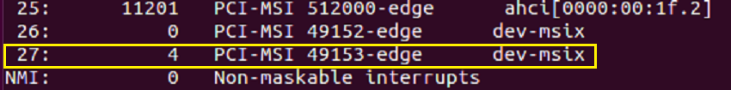
IMS Example Usage
1. Load the native device driver
2. Load the vfio-mdev module
3. Create mediated device
4. Pass mdev to *guest (e.g., *qemu)
5. Run some device operation in guest
6. Check /proc/interrupts:
in host: IMS interrupts
on guest: either IMS or MSI-X
On host:
On guest:
@twitter handle

Slide 17
Current Status
IMS infrastructure patches ready, testing done on simulator
To be sent to Linux* Kernel Mailing List (LKML) for review
Group based IMS allocation:
Submitted RFC patch for dynamic MSI-x:
https://lkml.org/lkml/2019/6/21/923
@twitter handle

Slide 18
Summary
IMS is a scalable interrupt mechanism for SIOV devices
Its size and location are device specific
A new IMS IRQ chip and IRQ domain has been added support IMS interrupts
IMS spec:
https://software.intel.com/sites/default/files/managed/cc/0e/intel-scalable-io-virtualization-technical-specification.pdf
  Section 3.4.1
@twitter handle

Slide 19
Thank you!
Questions?

